Slide 1
Areas of Assessment
Livelihood zones
Framework

Slide 2
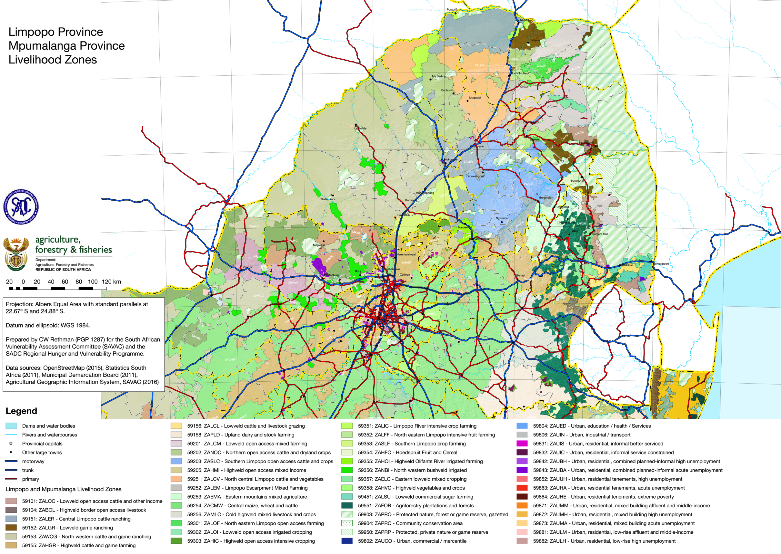

Slide 3
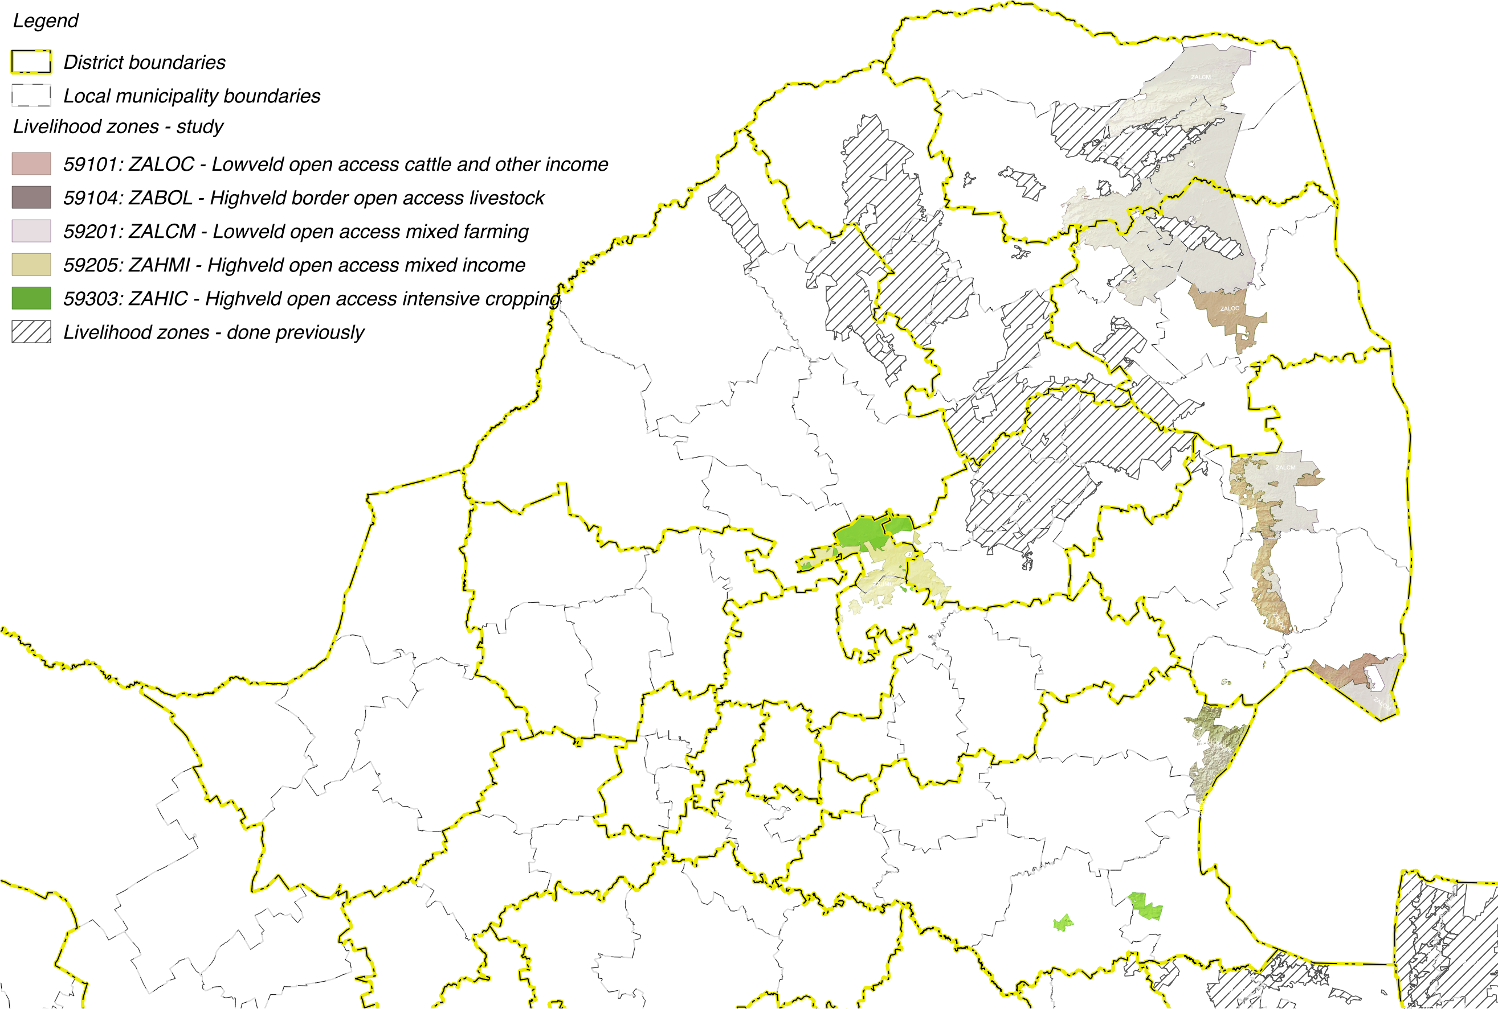

Slide 4
Livelihoods Findings:
Wealth Descriptions and Wealth Breakdowns

Slide 5
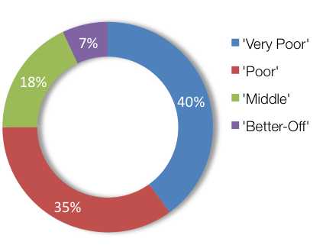
Wealth Breakdowns & Descriptions: ZALCM – Lowveld Open Access Mixed Farming (59201)
WEALTH GROUP | LIVESTOCK (cattle) | FARM SIZE (ha) | MAIN INCOME
Very Poor | 0 – 7 [4] | 1.0 | Grants
Poor | 3 – 10 [5] | 1.5 | Grants
Middle | 10 – 50 [20] | 2.0 | Employ
Better Off | 15 – 200 [50] | 2.0 | Employ/agric

Slide 6
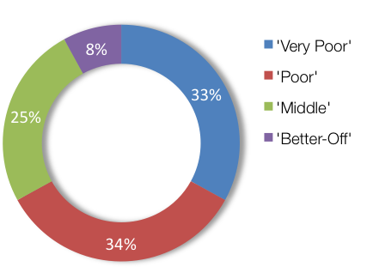
Wealth Breakdowns & Descriptions: ZAHIC – Highveld Open Access Intensive Cropping (59303)
WEALTH GROUP | LIVESTOCK (cattle) | FARM SIZE (ha) | MAIN INCOME
Very Poor | 0 | 0.75 | Grants
Poor | 0 – 4 [2] | 1.0 | Grants
Middle | 0 – 15 [10] | 1.2 | Employ
Better Off | 5 – 60 [30] | 2.0 | Employ/agric

Slide 7
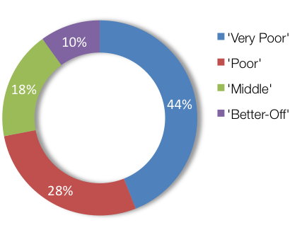
Wealth Breakdowns & Descriptions: ZABOL – Highveld border open access livestock (59104)
WEALTH GROUP | LIVESTOCK (cattle) | FARM SIZE (ha) | MAIN INCOME
Very Poor | 0 | 0.25 | Grants
Poor | 0 – 4 [3] | 0.5 | Grants
Middle | 5 – 13 [10] | 1.0 | Employ
Better Off | 10 – 25 [20] | 2.0 | Employ

Slide 8
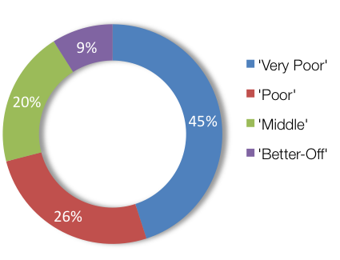
Wealth Breakdowns & Descriptions: ZALOC – Lowveld Open Access Cattle and Other Income (59101)
WEALTH GROUP | LIVESTOCK (cattle) | FARM SIZE (ha) | MAIN INCOME
Very Poor | 0 | 0.2 | Grants
Poor | 0 – 4 [2] | 0.3 | Grants
Middle | 0 – 15 [10] | 0.3 | Employ
Better Off | 5 – 60 [30] | 4.0 | Employ

Slide 9
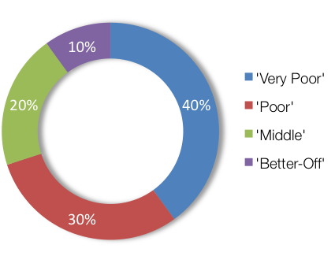
Wealth Breakdowns & Descriptions: ZAHMI – Highveld Open Access Mixed Income (59205)
WEALTH GROUP | LIVESTOCK (cattle) | FARM SIZE (ha) | MAIN INCOME
Very Poor | 0 | 0.5 | Grants
Poor | 0 – 7 [3] | 0.5 | Grants
Middle | 6 – 10 [8] | 0.5 | Employ
Better Off | 10 – 20 [15] | 0.5 | Employ

Slide 10
Livelihoods Findings:
Sources of Food and Income

Slide 11
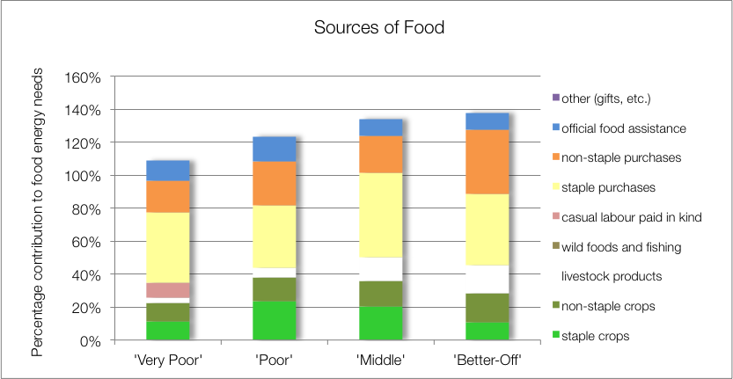
Source of Food: ZALCM – Lowveld Open Access Mixed Farming (59201)
Key findings:
Crops (maize, beans, w.melon, gnuts, roundnuts & pumpkin) important to food (23%-38%)
Food purchase >50%
School feeding to all WGS
Notes:
DON’T CLICK TOO FAST THROUGH THE ANIMATIONS!!

Slide 12
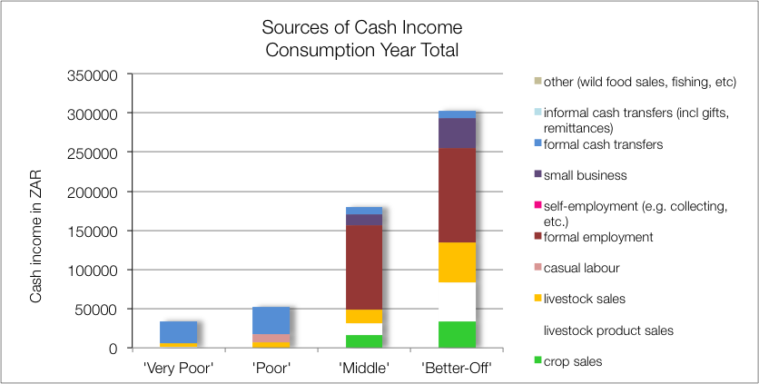
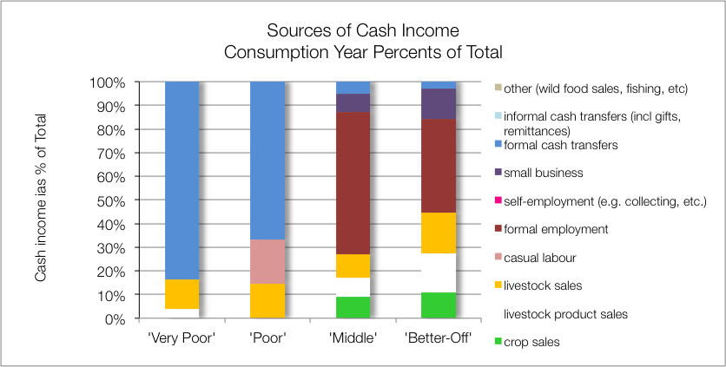
Source of Cash: ZALCM – Lowveld Open Access Mixed Farming (59201)
Key findings:
Agriculture (crops and livestock) income high (up to 45%)
Formal employemnt (BO & M)
Grants (VP & P)
Casual labour (P)
Notes:
DON’T CLICK TOO FAST THROUGH THE ANIMATIONS!!
Explain the difference between the two graphs: the upper is the absolute values (in Rands) and the lower is proportions of totals (in %).

Slide 13
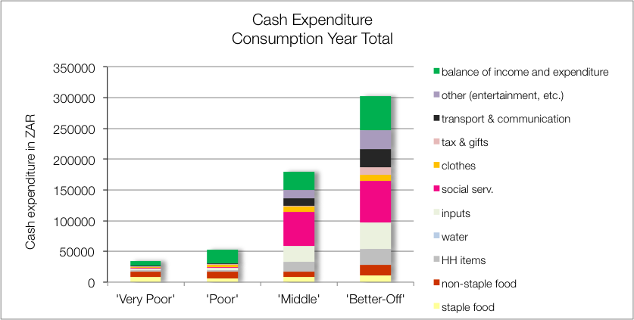
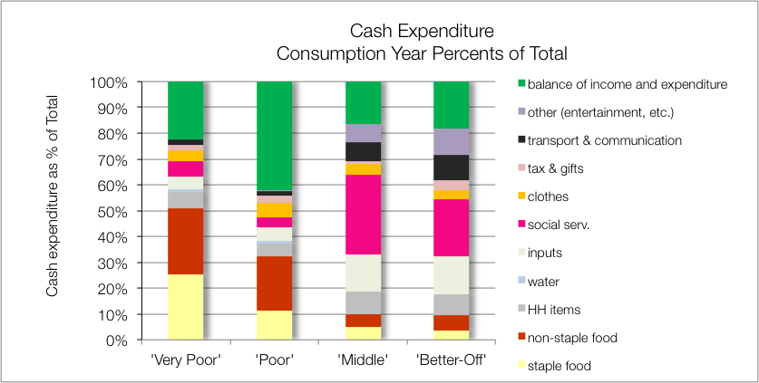
Source of Cash: ZALCM – Lowveld Open Access Mixed Farming (59201)
Key findings:
Soc Services (school, health), M ~30% & BO ~22%
Inputs (incl labour), M & BO ~15%
Food, VP >50% & P >30%)

Slide 14
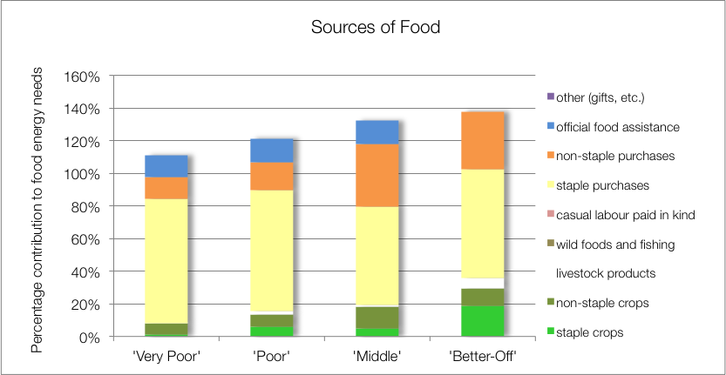
Sources of Food: ZAHIC – Highveld Open Access Intensive Cropping (59303)
Key findings:
Crops (maize, beans, w.melon & pumpkin) important, M & BO 38%
Food purchase >50%
School feeding to all WGS

Slide 15
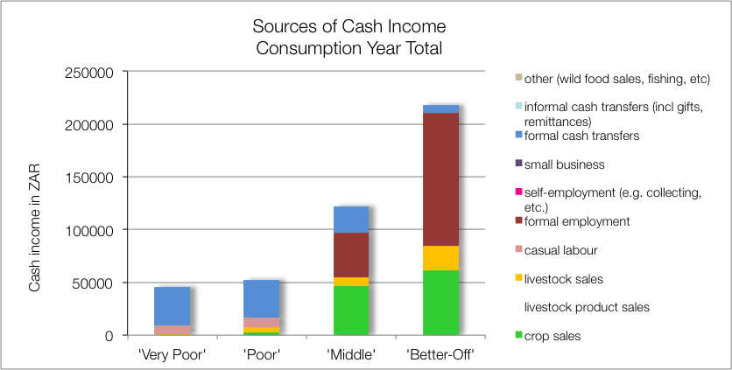
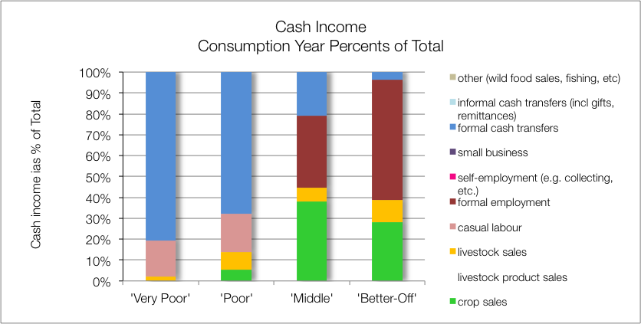
Sources of Cash: ZAHIC – Highveld Open Access Intensive Cropping (59303)

Slide 16
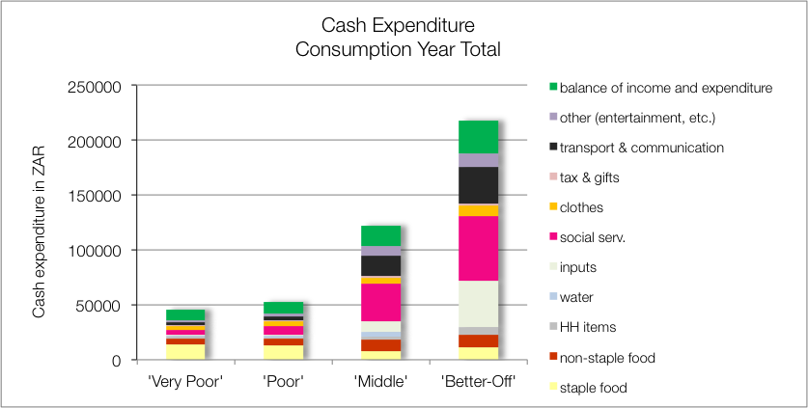
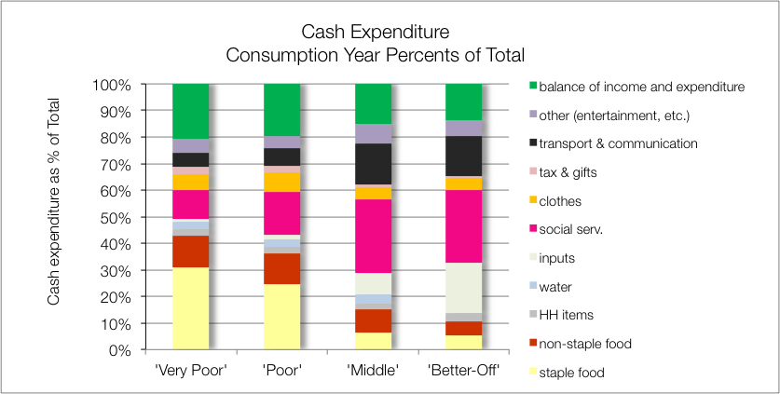
Sources of Cash: ZAHIC – Highveld Open Access Intensive Cropping (59303)

Slide 17
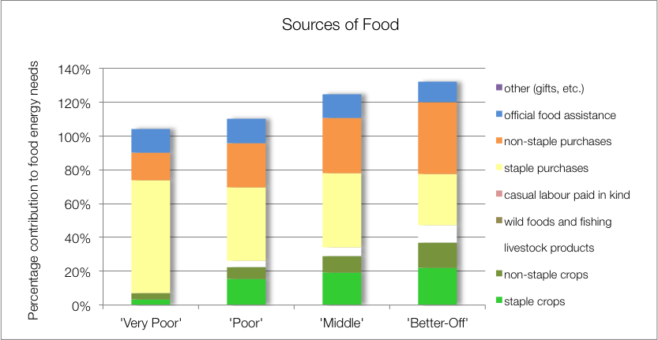
Sources of Food: ZABOL – Highveld border open access livestock (59104)
Key finding:
Low yields and productivity

Slide 18
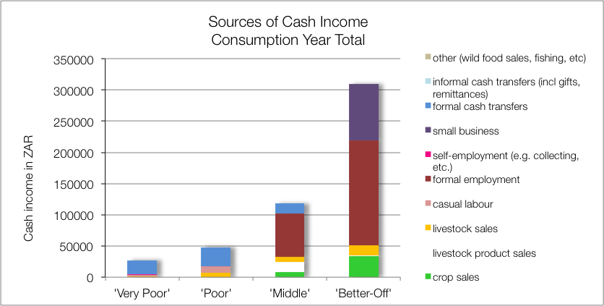
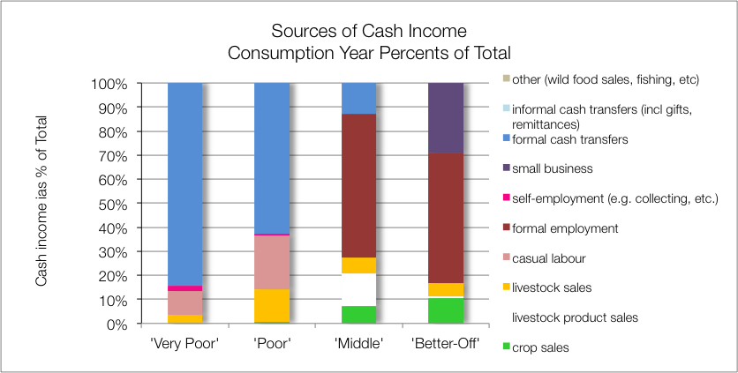
Sources of Cash: ZABOL – Highveld border open access livestock (59104)

Slide 19
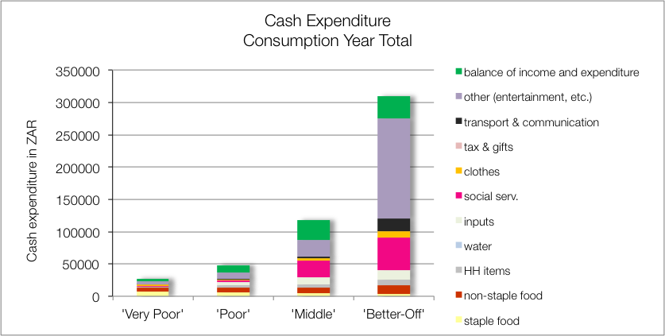
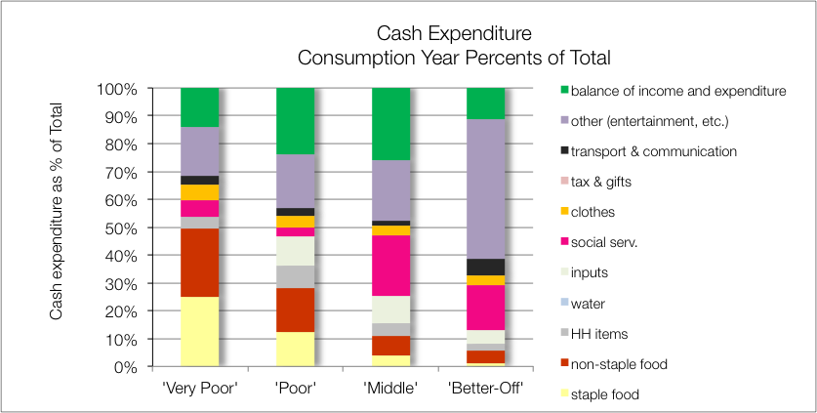
Sources of Cash: ZABOL – Highveld border open access livestock (59104)

Slide 20
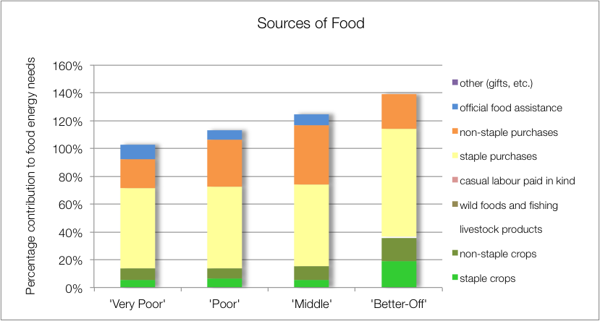
Sources of Food: ZALOC – Lowveld Open Access Cattle and Other Income (59101)

Slide 21
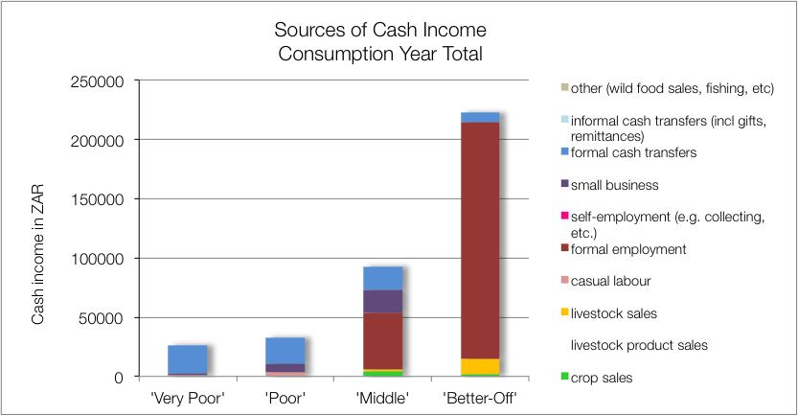
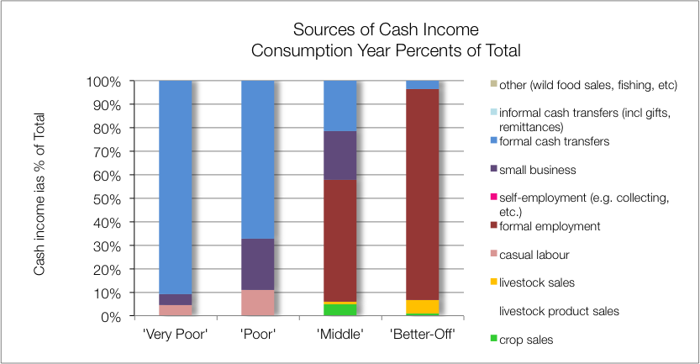
Sources of Cash: ZALOC – Lowveld Open Access Cattle and Other Income (59101)

Slide 22
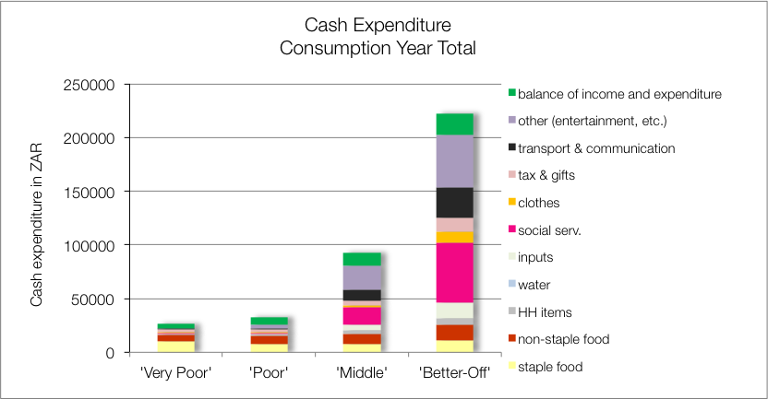
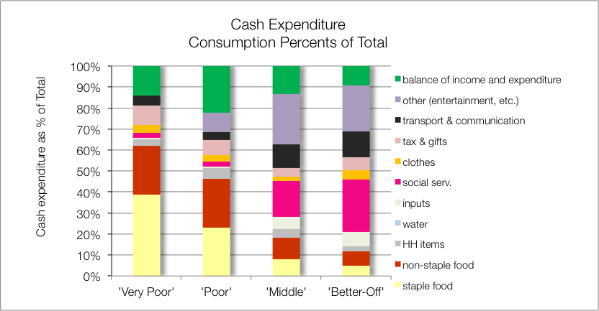
Sources of Cash: ZALOC – Lowveld Open Access Cattle and Other Income (59101)

Slide 23
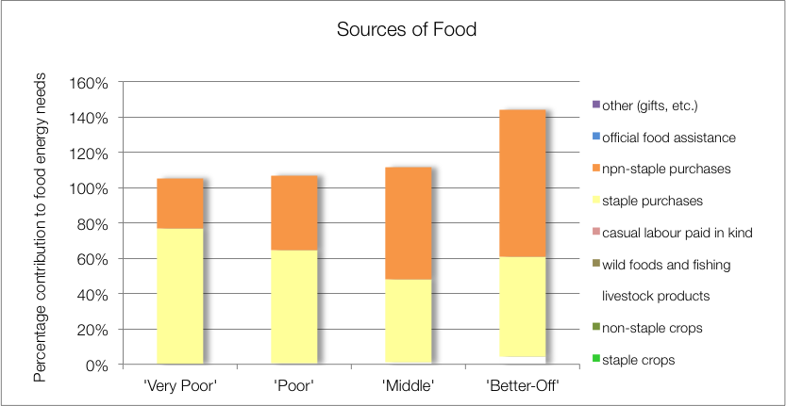
Sources of Food: ZAHMI – Highveld Open Access Mixed Income (59205)

Slide 24
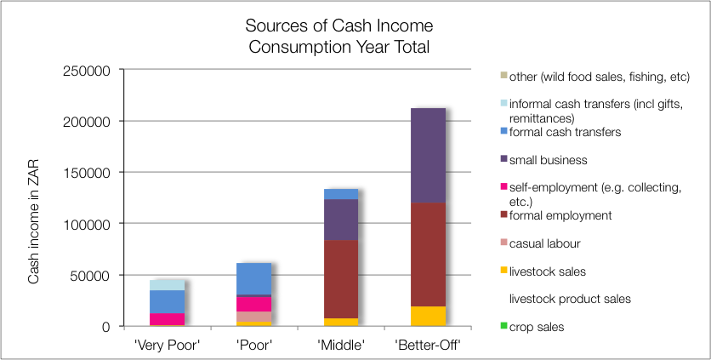
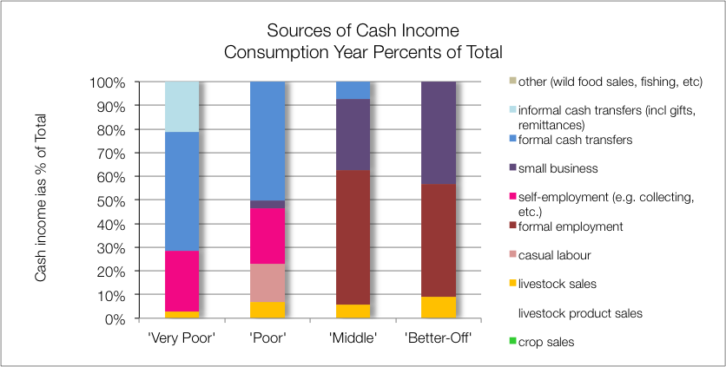
Sources of Cash: ZAHMI – Highveld Open Access Mixed Income (59205)

Slide 25
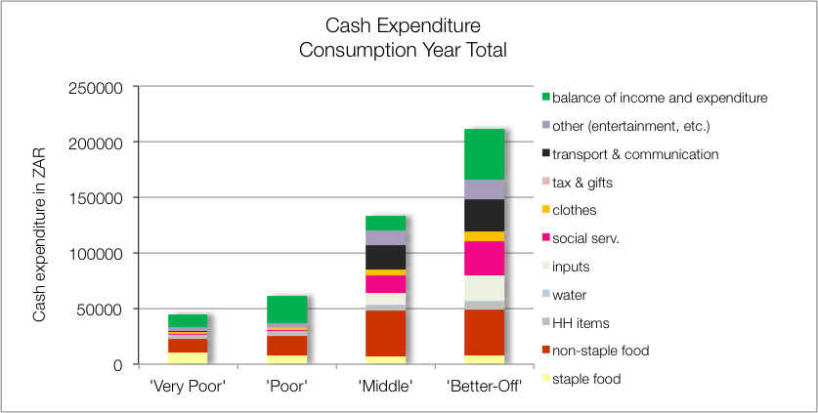
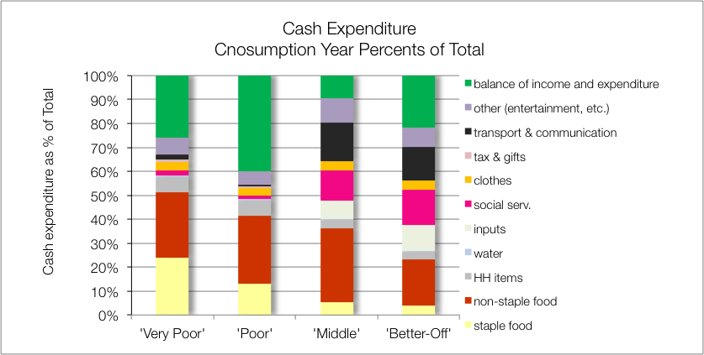
Sources of Cash: ZAHMI – Highveld Open Access Mixed Income (59205)

